Slide 1
2
Basic
__________

Slide 2
__________— and Energy
__________—anything that occupies space and has mass (weight)
__________——the ability to do work
__________—
__________—
__________—
__________—

Slide 3
Composition of __________—
__________— __________—units of matter
__________— percent of the body is made from four __________—
__________—(C)
Oxygen (__________—)
__________—(H)
__________—(N)
__________ __________—blocks of elements

Slide 4
__________— Particles
__________—
__________—(p⁺)
__________—(n⁰)
__________— the nucleus
__________—(e–)
Number of __________— equals numbers of __________— in an atom

Slide 5
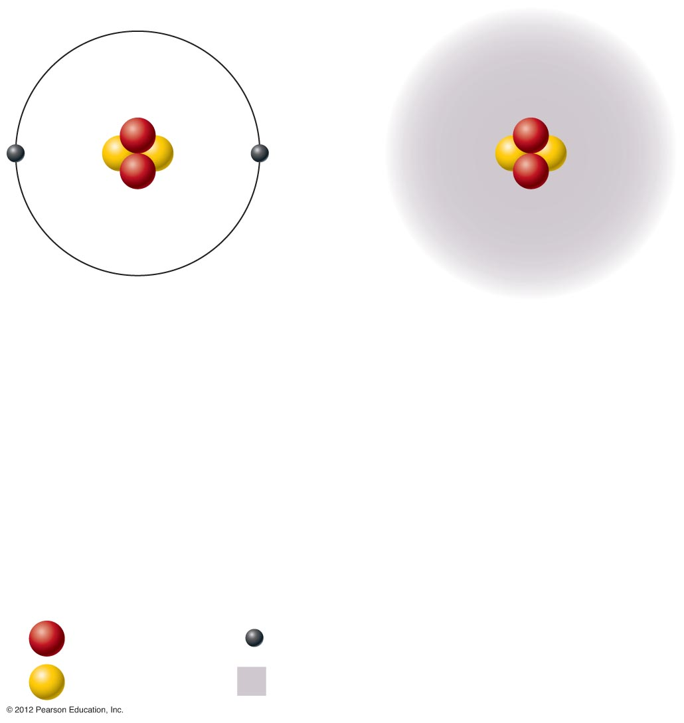
__________—
__________—
__________— atom
__________— atom
2 __________—(p⁺)
2 neutrons (n⁰)
2 __________—(e–)
2 protons (p⁺)
2 __________—(n⁰)
2 electrons (e–)
(a) __________— model
(b) __________— model
KEY:
= __________—
= __________—
= __________—
= __________— cloud
Figure 2.1

Slide 6
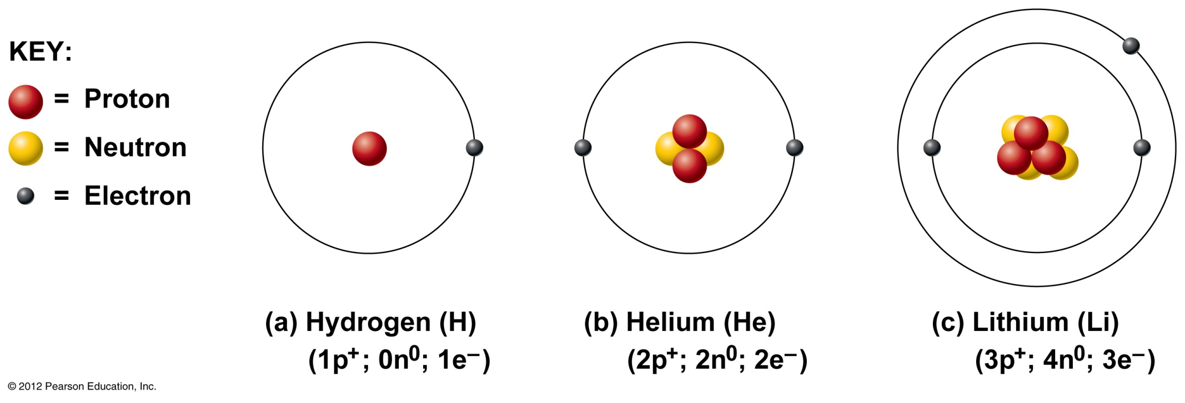
Figure 2.2

Slide 7
Identifying Elements
__________— number— equal to the number of protons that the atom contains
__________— __________—number—sum of the __________— and neutrons

Slide 8
__________— and Atomic Weight
__________—
Atoms of the same element with the same number of __________— and the same __________— number
Vary in number of __________—

Slide 9
Figure 2.3

Slide 10
__________— and Atomic Weight
__________— weight
Close to __________—number of most abundant isotope
__________— weight reflects natural __________— variation

Slide 11
__________—
__________
__________ isotope
Tends to be __________
__________ to more __________ isotope
__________ __________ of spontaneous __________ decay

Slide 12
__________ and __________
__________ __________ or more atoms of the same elements combined chemically
__________ __________ or more atoms of __________ elements combined chemically

Slide 13
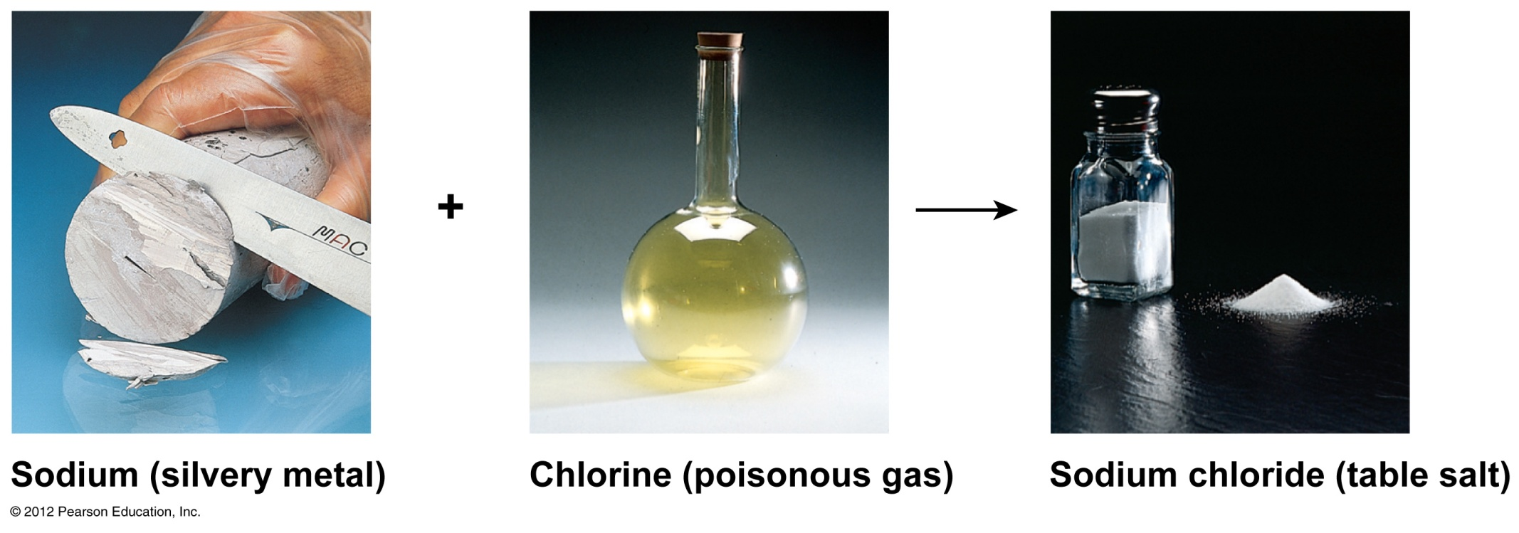
Figure 2.4

Slide 14
__________ Reactions
Atoms are united by __________ bonds
Atoms __________ from other atoms when __________ bonds are broken

Slide 15
__________ and Bonding
__________ occupy energy levels called __________ shells
__________ closest to the __________ are most strongly __________
Each shell has __________ properties
The number of __________ has an upper limit
__________ closest to the __________ fill first

Slide 16
__________ and Bonding
__________ involves __________ between __________ in the outer shell (valence shell)
Full __________ shells do not form __________

Slide 17
__________ Elements
Atoms are __________(__________) when the outermost shell is __________
How to fill the atom’s shells
Shell 1 can hold a maximum of __________ electrons
Shell 2 can hold a maximum of __________ electrons
Shell 3 can hold a maximum of __________ electrons

Slide 18
__________ Elements
__________ will gain, lose, or share electrons to complete their outermost __________ and reach a __________ state
Rule of __________
__________ are considered stable when their outermost orbital has __________ electrons
The __________ to this rule of eights is Shell 1, which can only hold 2 electrons

Slide 19
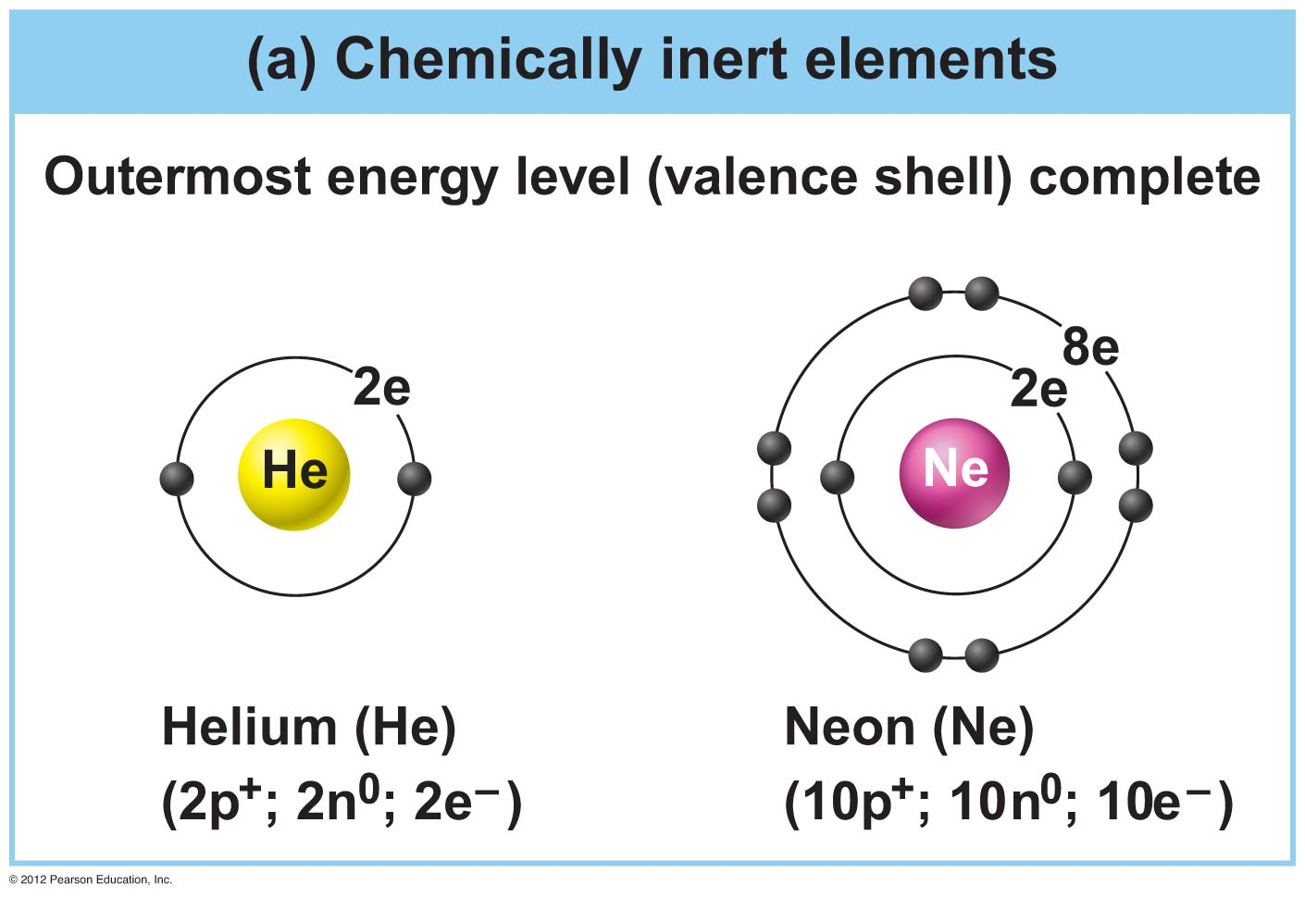
Figure 2.5a

Slide 20
__________ Elements
Valence shells are not full and are __________
__________ to gain, lose, or __________ electrons
Allow for bond __________, which produces __________ valence

Slide 21
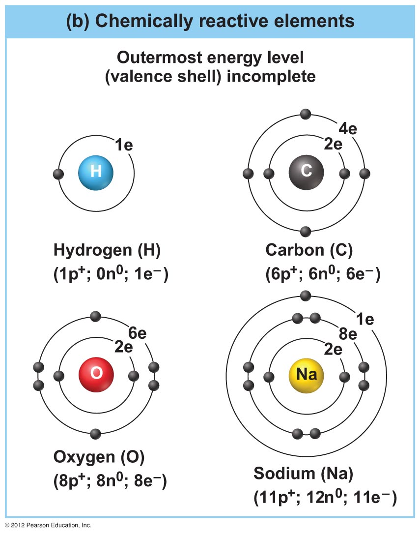
Figure 2.5b

Slide 22
__________ Bonds
__________ bonds
Atoms become __________ through the transfer of electrons
Form when __________ are completely __________ from one __________ to another
__________
Result from the __________ or gain of electrons
__________ are __________ due to gain of electron(s)
__________ are __________ due to loss of electron(s)

Slide 23
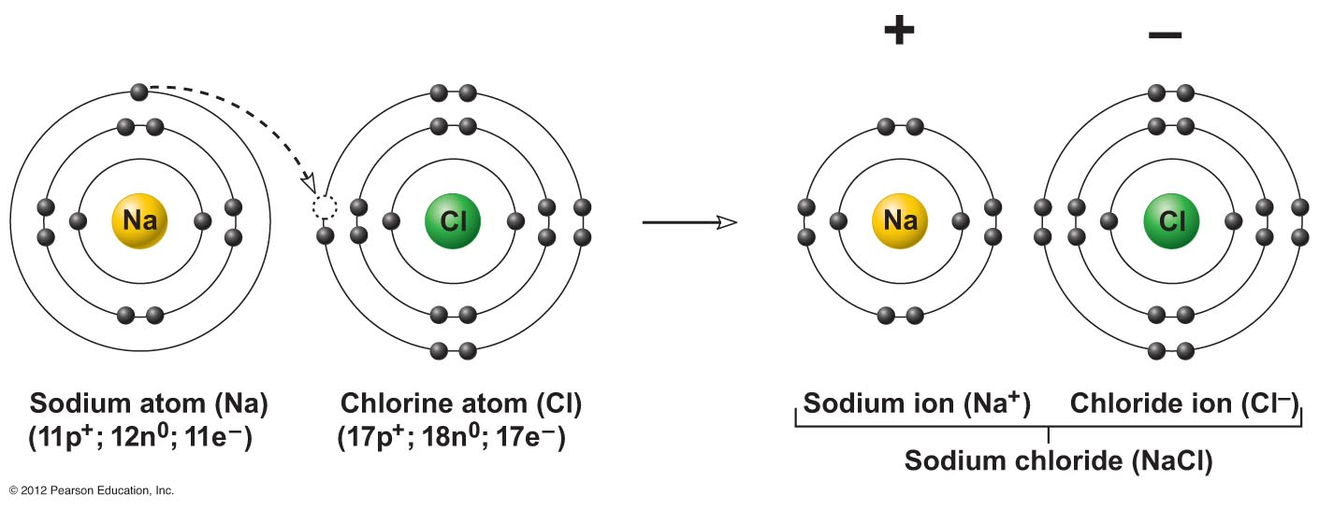
Figure 2.6

Slide 24
Figure 2.6, step 1

Slide 25
Figure 2.6, step 2

Slide 26
Figure 2.6, step 3

Slide 27
__________ Bonds
__________ bonds
Atoms become __________ through shared __________
__________ are shared in pairs
Single __________ bonds share one pair of __________
Double __________ bonds share __________ pairs of electrons

Slide 28
Figure 2.7a

Slide 29
Figure 2.7b

Slide 30
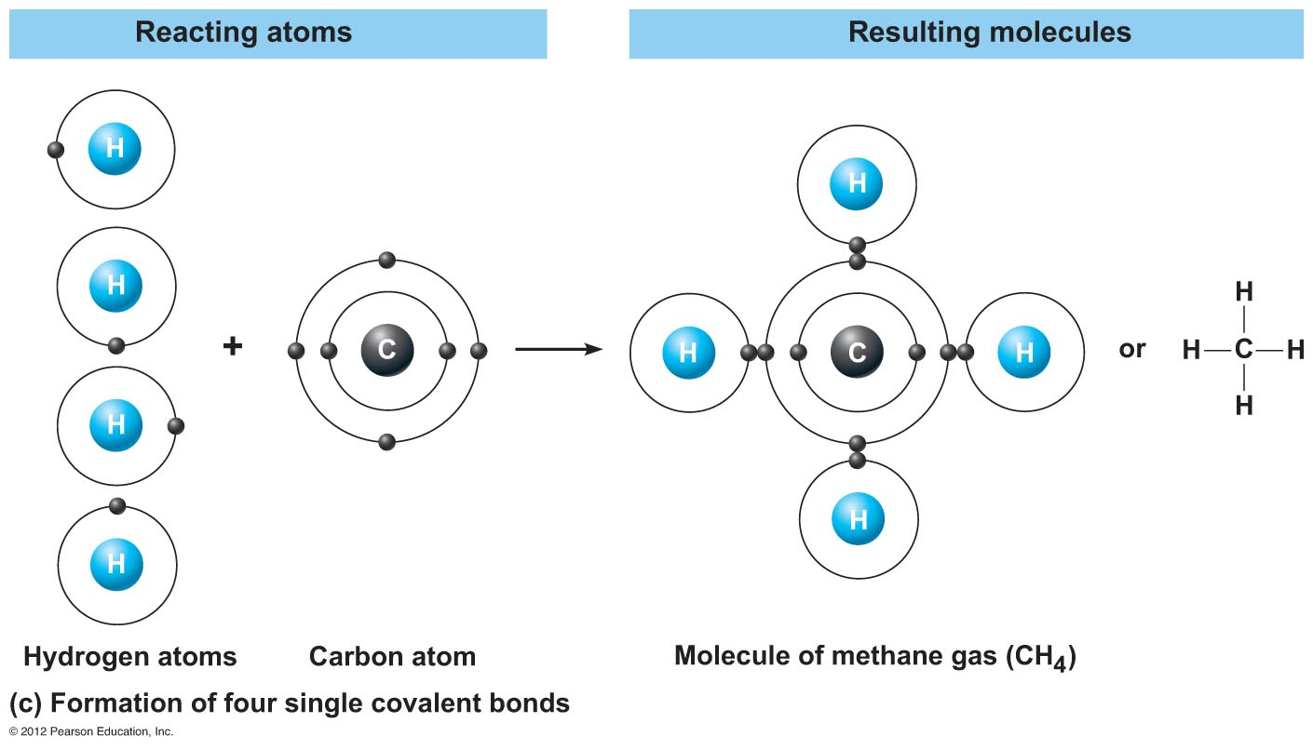
Figure 2.7c

Slide 31
__________ Bonds
__________ bonds are either __________ or polar
__________
__________ are shared equally between the atoms of the __________
__________ neutral as a __________

Slide 32
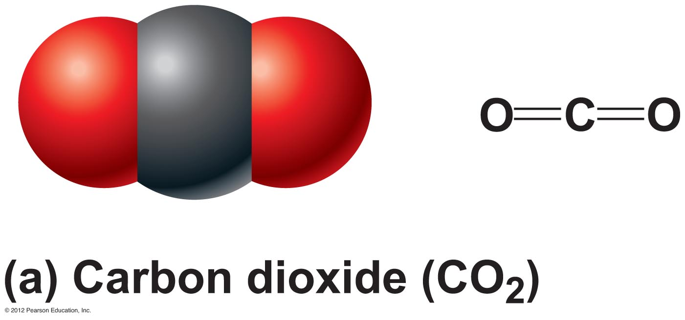
Figure 2.8a

Slide 33
Covalent Bonds
__________ bonds are either __________ or polar
__________
__________ are not shared __________ between the atoms of the molecule
Have a __________ and __________ side or pole

Slide 34
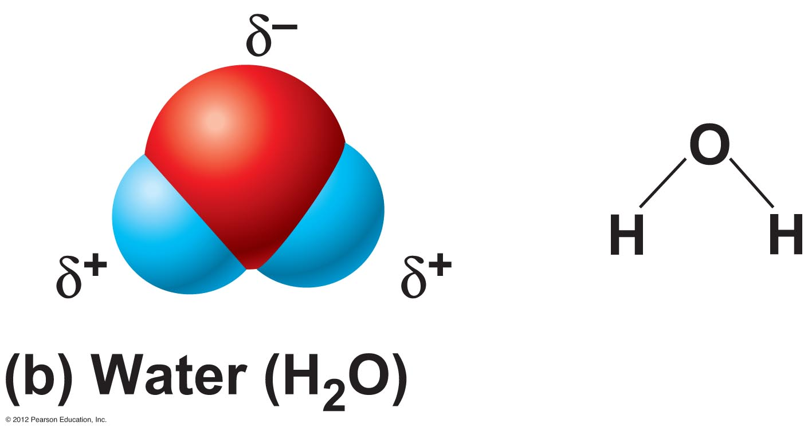
Figure 2.8b

Slide 35
__________ Bonds
__________ bonds
Weak __________ bonds
__________ is attracted to the __________ portion of polar molecule
Provides __________ between __________

Slide 36
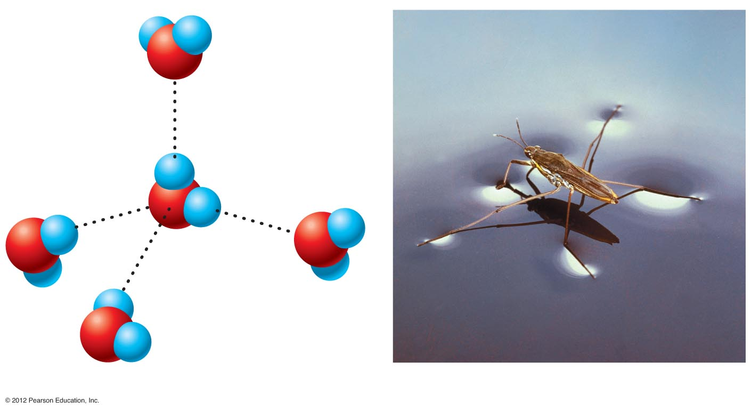
δ⁺
H
H
O
δ–
Hydrogen bonds
δ⁺
H
O
H
δ⁺
δ–
δ–
δ–
H
H
O
O
δ⁺
δ⁺
H
H
H
δ⁺
O
H
δ–
(a)
(b)
Figure 2.9

Slide 37
__________ of __________ Reactions
__________ reaction (A + B→AB)
Atoms or __________ combine
__________ is absorbed for bond formation
__________ reaction (AB→A + B)
__________ is broken down
__________ energy is released

Slide 38
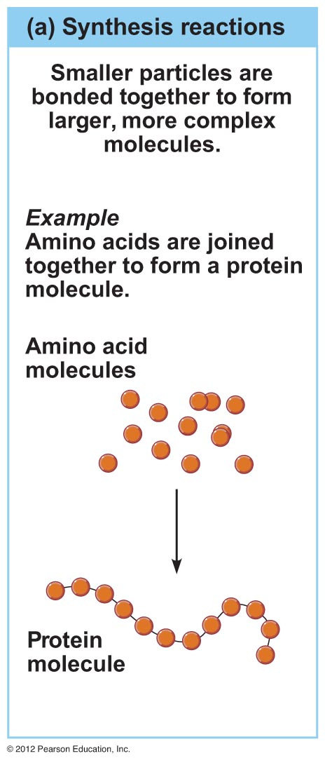
Figure 2.10a

Slide 39
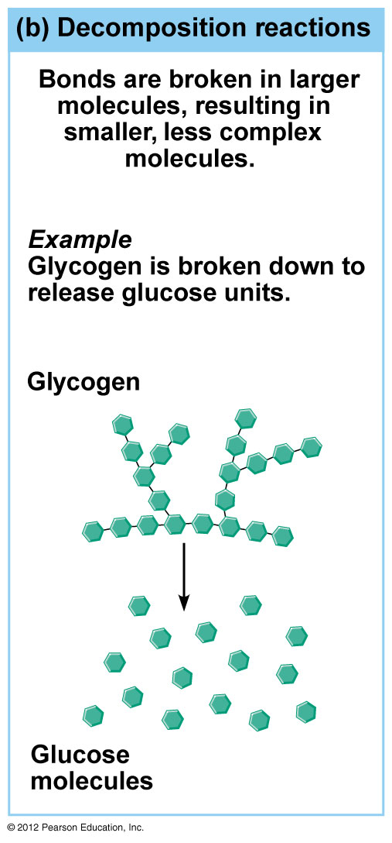
Figure 2.10b

Slide 40
Patterns of __________ Reactions
__________ reaction (__________ _______)
Involves both __________ and __________ reactions
Switch is made between __________ parts and different __________ are made

Slide 41
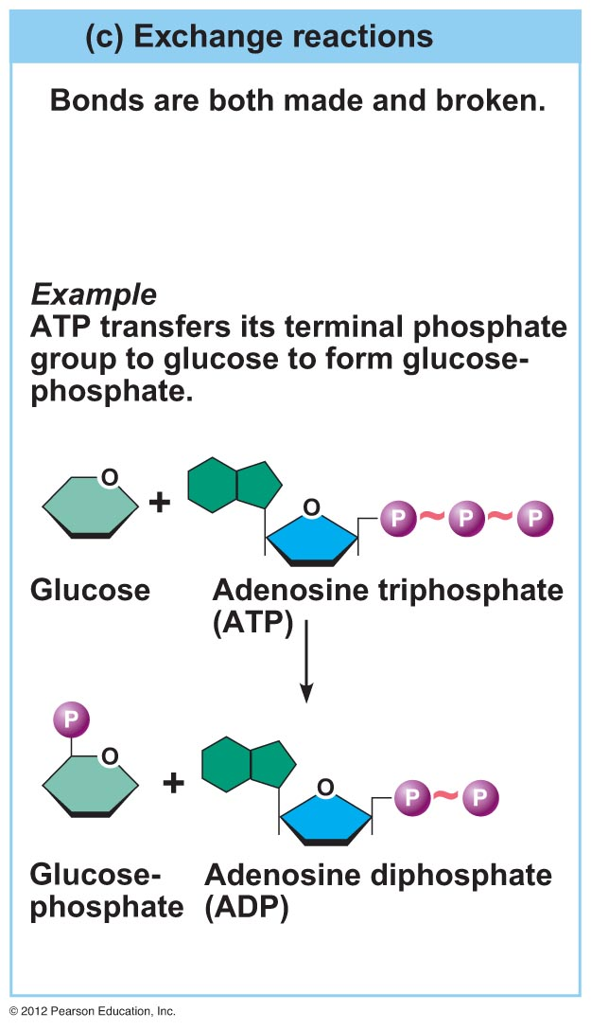
Figure 2.10c

Slide 42
__________ __________ : Essentials for Life
__________ compounds
Contain __________
Most are __________ bonded
Includes __________, __________, proteins, __________
__________ compounds
Lack __________
Tend to be __________ compounds
Includes __________, __________, and some __________ and __________

